Slide 1
Introduction to Partial Least Squares Discriminant Analysis (PLS-DA)

Slide 2
What is PLS-DA?
Partial Least Squares Discriminant Analysis (PLS-DA) is a supervised classification method.
Combines features of Partial Least Squares (PLS) regression with discriminant analysis.
Useful for handling multicollinearity and high-dimensional data.

Slide 3
Applications of PLS-DA
Datasets with correlated and noisy variables.
Fields: Chemometrics, Bioinformatics, Metabolomics, and Sensory Data.
Ideal for high-dimensional datasets where other classification methods struggle.

Slide 4
Basic Workflow of PLS-DA
1. Input: Predictor matrix X and response vector y.
2. Latent Variable Extraction: PLS-DA aims to Maximize covariance between Predictor matrix X and response vector y.
3. Dimensionality Reduction: Summarize X into latent variables.
4. Discriminant Analysis: Classify samples using latent variables. The idea is to project the data into a lower-dimensional space (formed by the latent variables) where the separation between the classes is maximized.

Slide 5
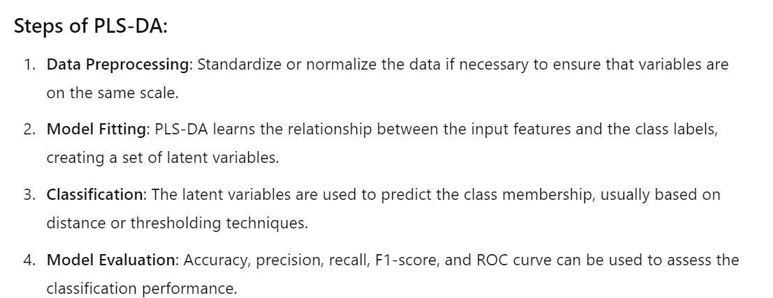

Slide 6
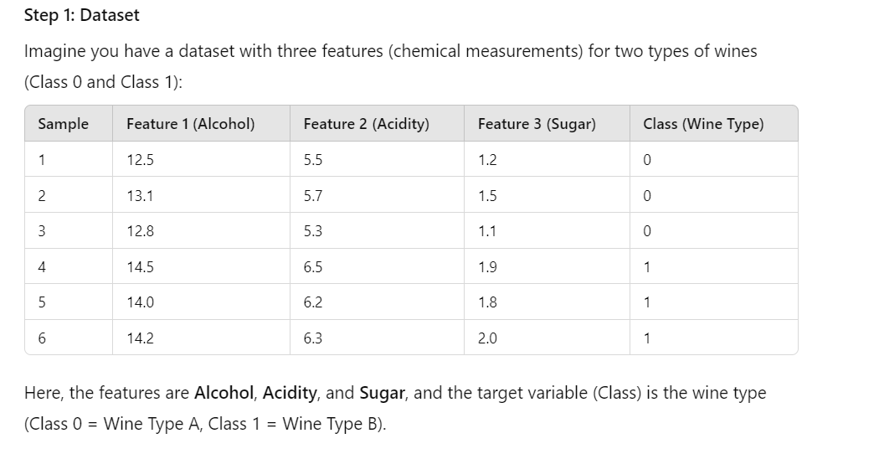
Wine Classification Example

Slide 7
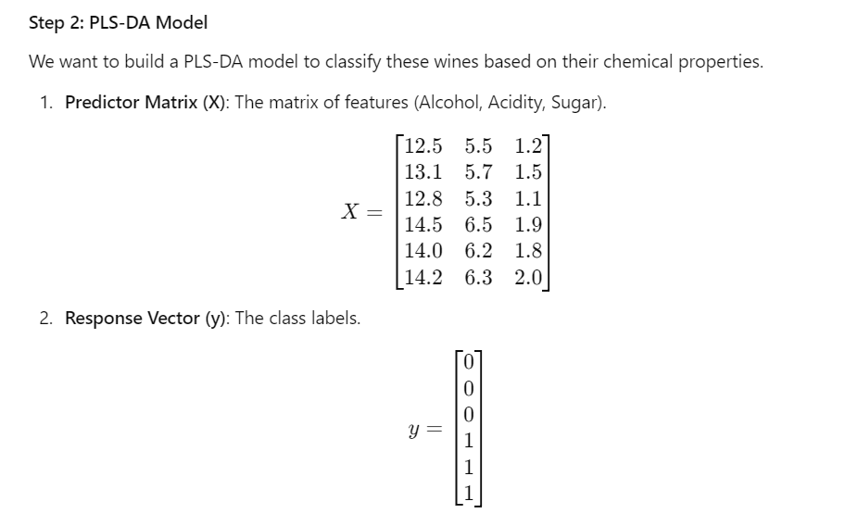

Slide 8
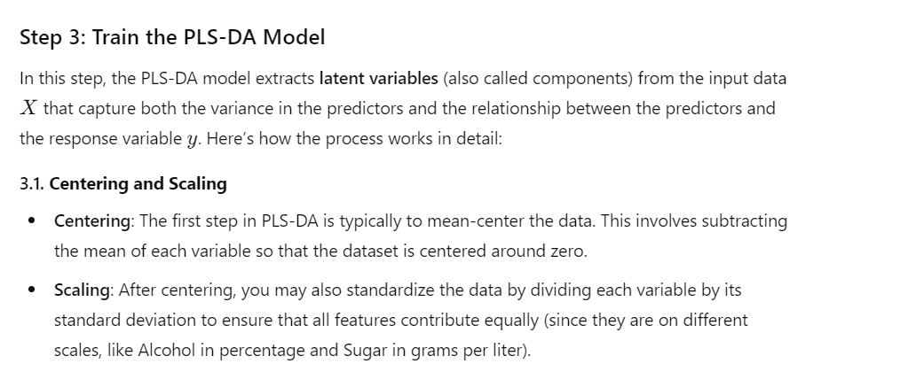

Slide 9
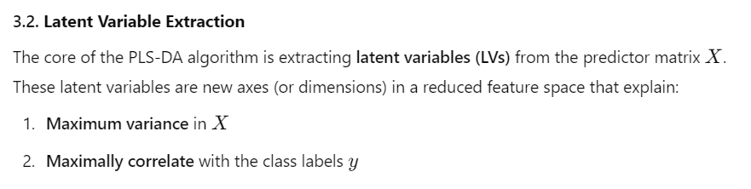
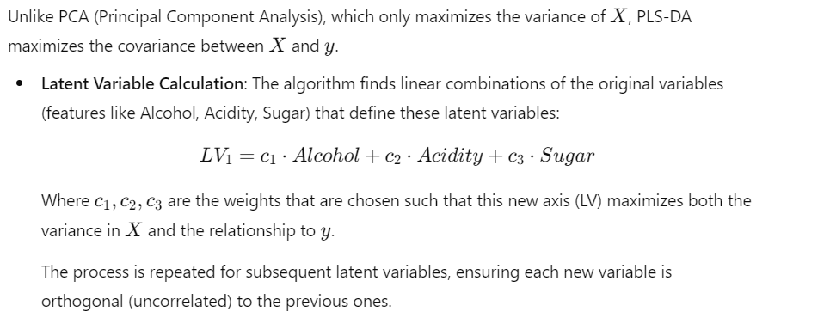

Slide 10
What Are Latent Variables?
Linear combinations of original features (e.g., LV₁ = c₁ × Alcohol + c₂ × Acidity + c₃ × Sugar).
Latent variables maximize both the variance in X and the correlation with y.
PLS-DA extracts a few important latent variables to separate classes.

Slide 11
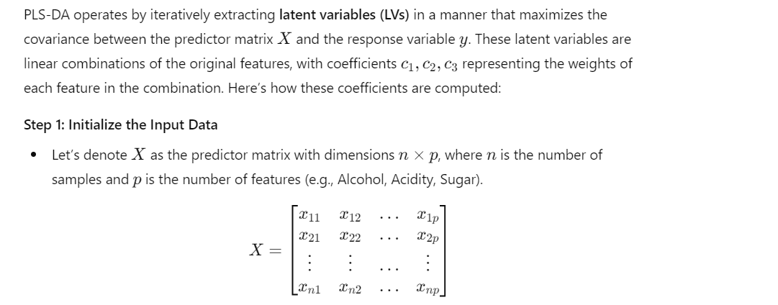
How Coefficients c₁, c₂, c₃ Are Calculated

Slide 12

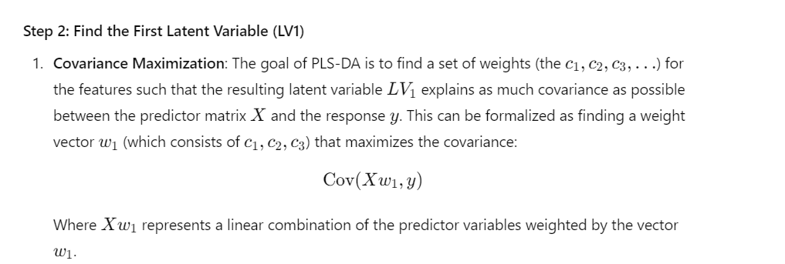

Slide 13
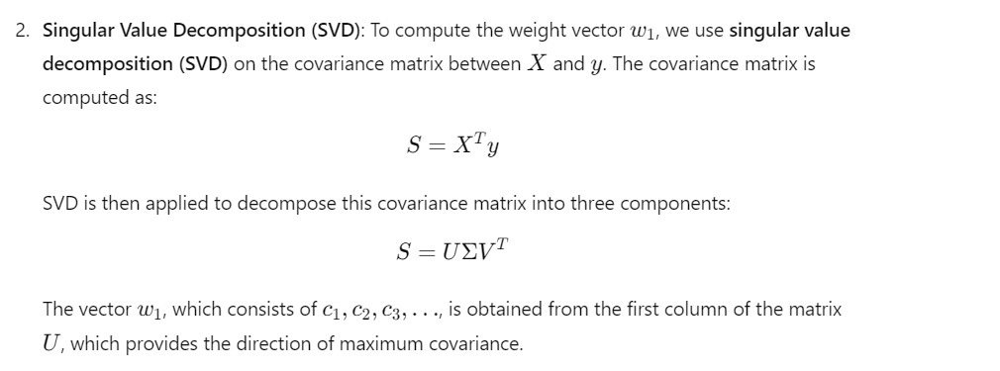

Slide 14
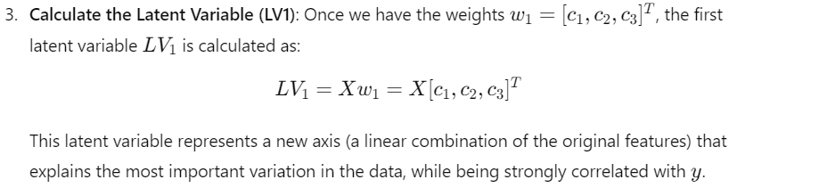

Slide 15
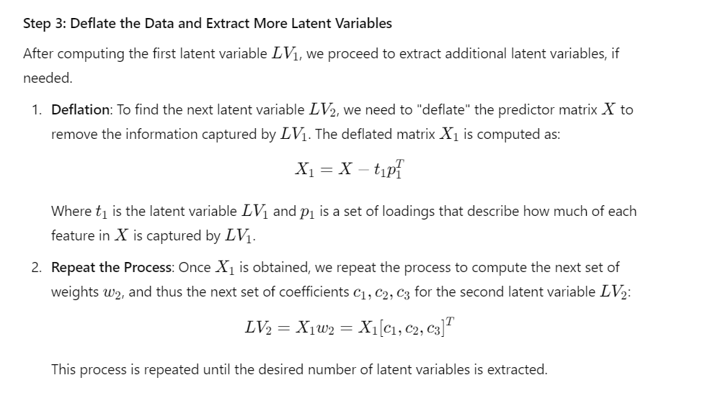

Slide 16
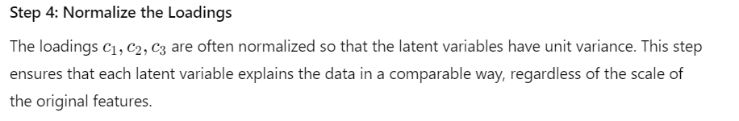
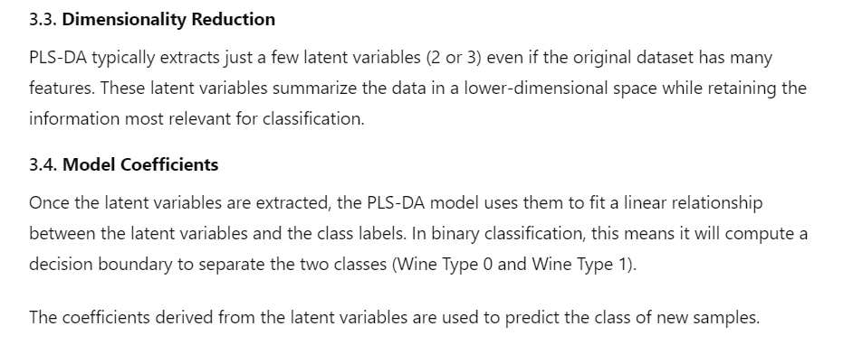

Slide 17
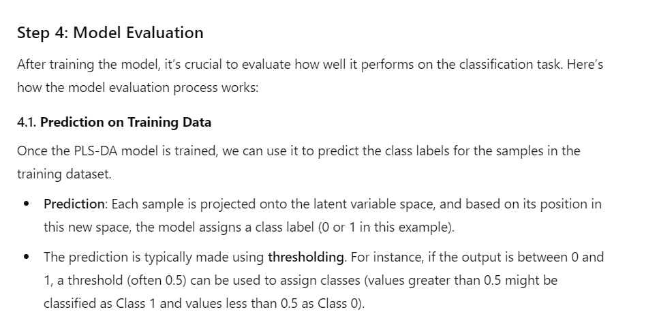

Slide 18
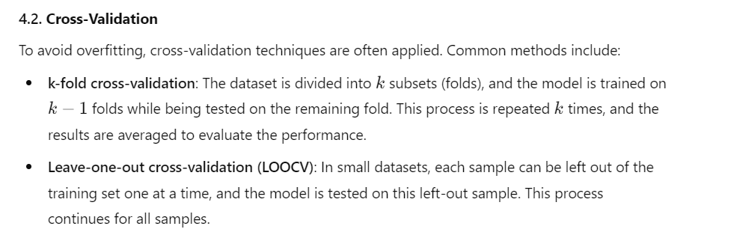

Slide 19
Evaluating PLS-DA Performance
Metrics: Accuracy, Precision, Recall, F1-Score, and AUC-ROC curve.
Confusion Matrix to evaluate classification performance.
Cross-validation: k-fold, LOOCV to prevent overfitting.

Slide 20
Why Use PLS-DA?
Handles multicollinearity in data.
Effective for high-dimensional datasets.
Provides interpretable results (VIP scores for feature importance).

Slide 21
Real-World Use Cases
Chemometrics: Chemical properties for product quality control.
Bioinformatics: Gene expression and metabolomics data.
Sensory Science: Food and beverage classification based on chemical attributes.

Slide 22
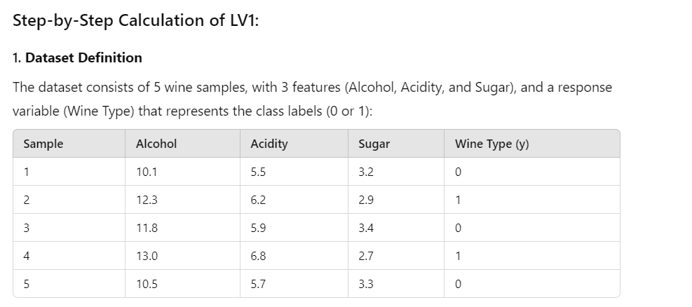

Slide 23
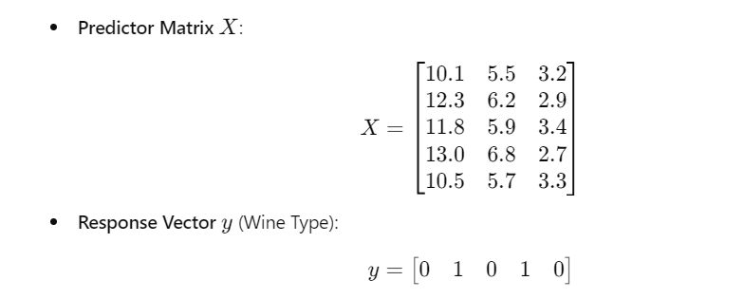

Slide 24
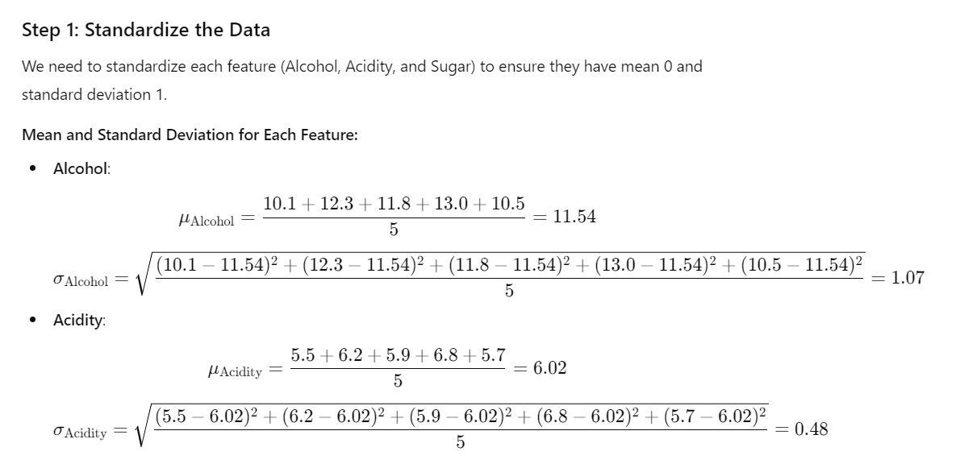
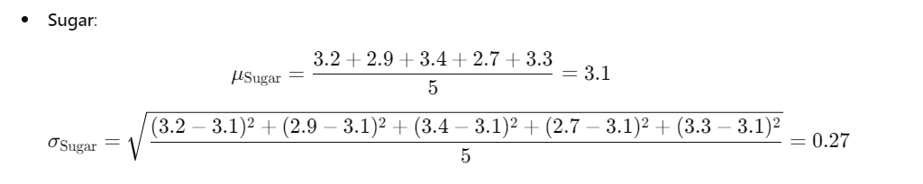

Slide 25
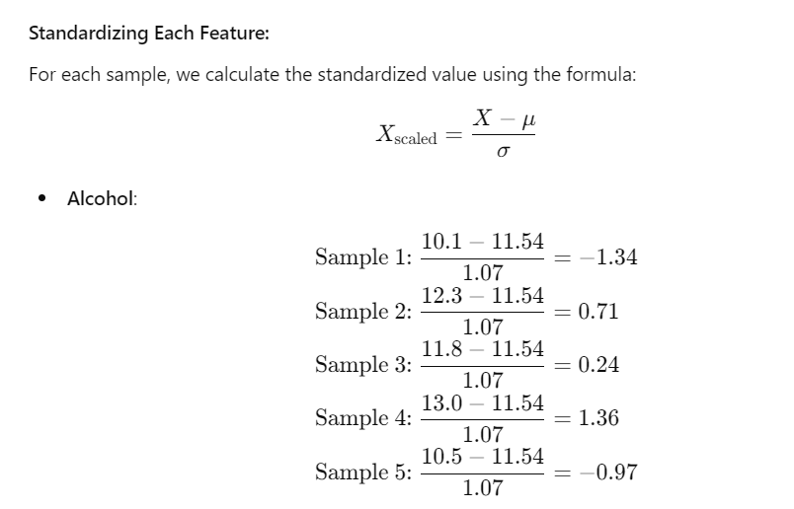

Slide 26
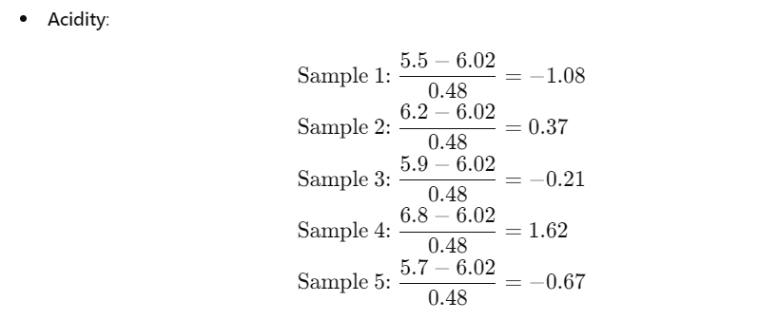
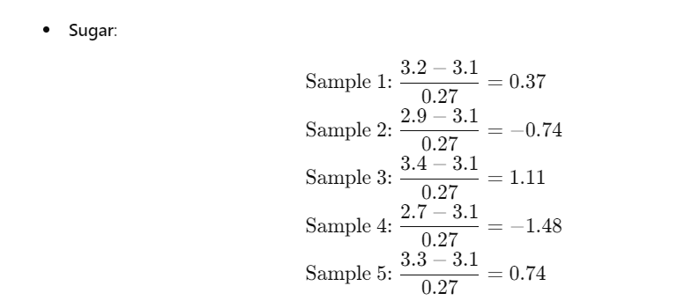

Slide 27
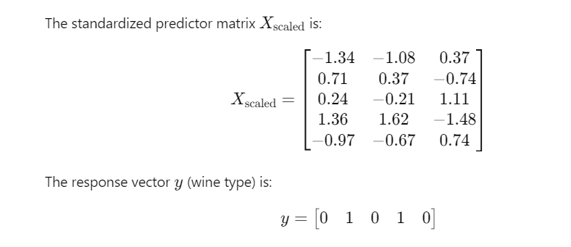

Slide 28
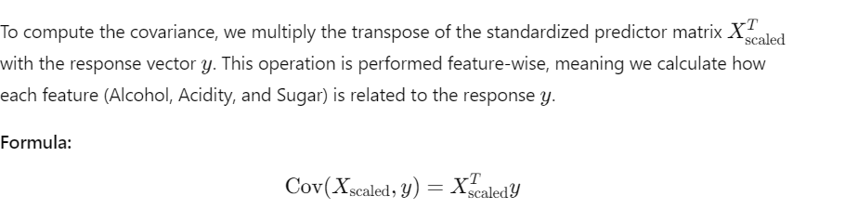
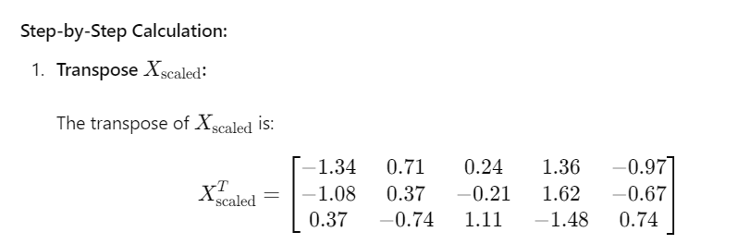

Slide 29
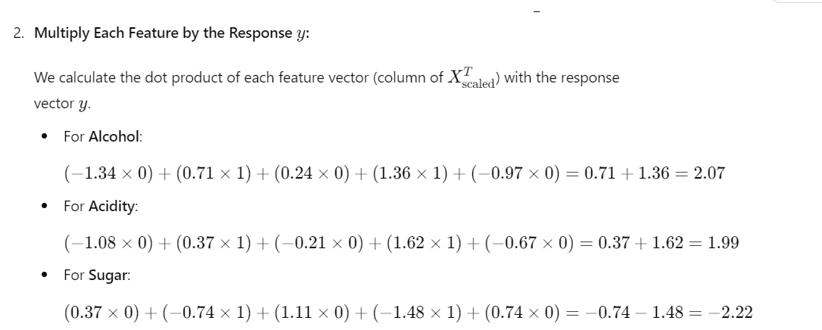

Slide 30
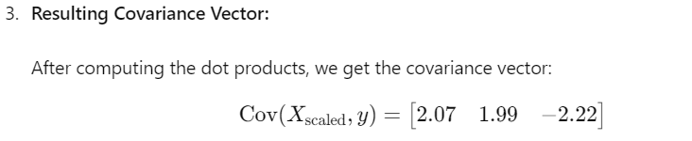
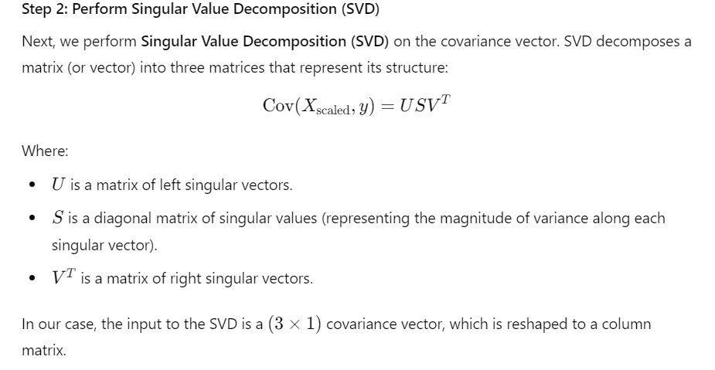

Slide 31
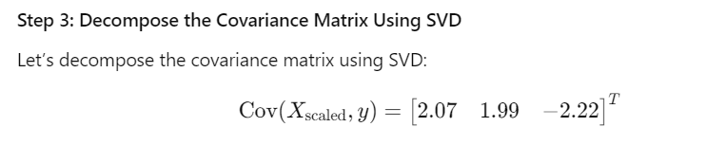
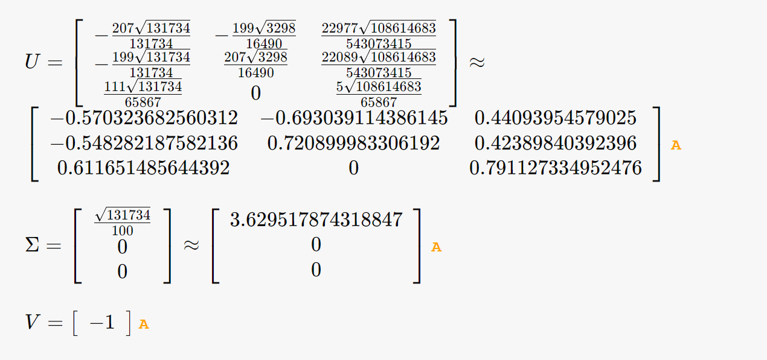

Slide 32
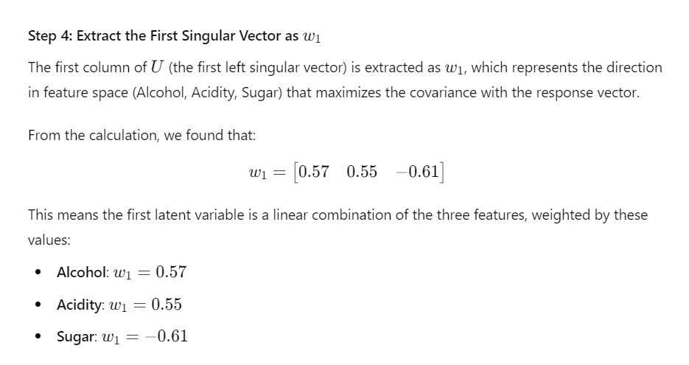

Slide 33
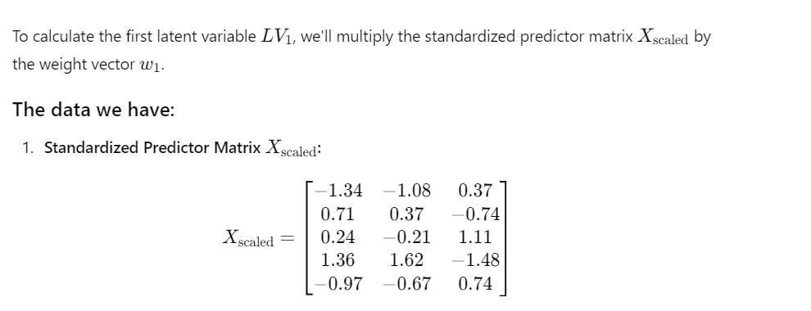

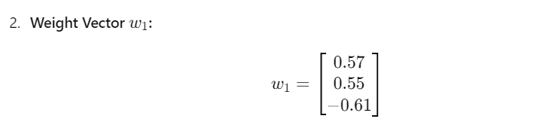

Slide 34
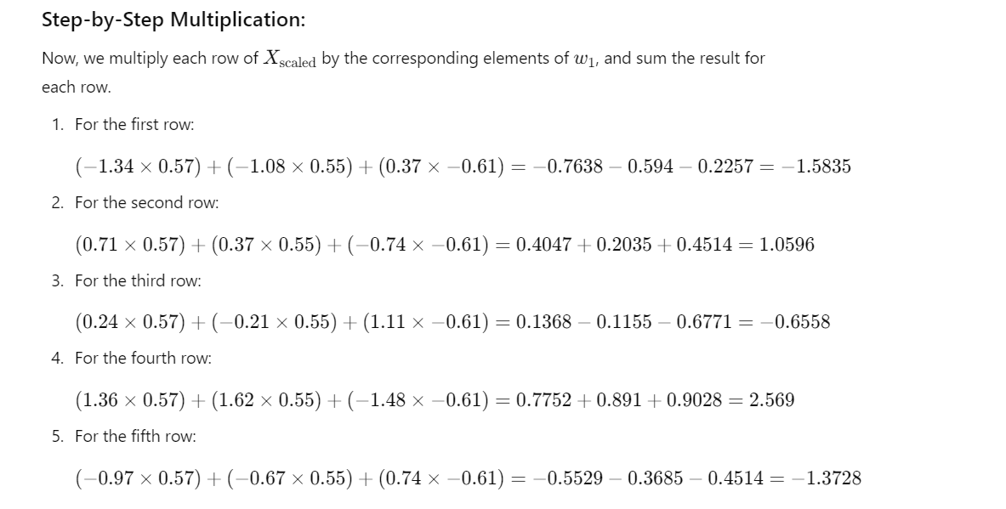

Slide 35
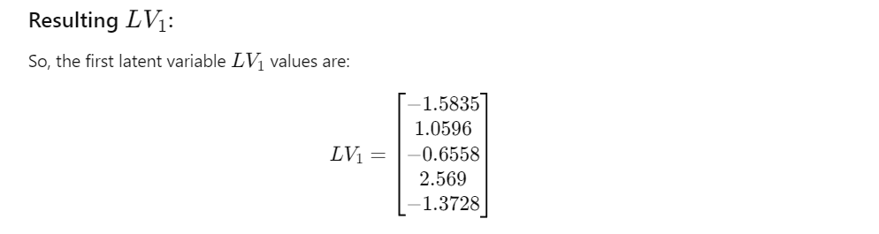

Slide 36
Summary
PLS-DA is a powerful classification tool for complex, multivariate datasets.
Combines dimensionality reduction with classification, making it useful in several scientific and industrial fields.
Provides both predictive accuracy and insight into important features.

